Slide 1
Design and Analysis of Algorithms NP-Completeness
Slides from: Haidong Xue

Slide 2
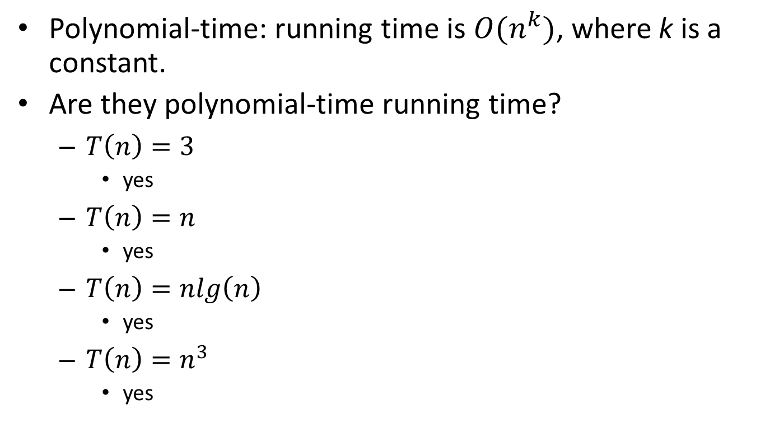
What is polynomial-time?
Polynomial-time: running time is $O(n^{k})$, where k is a constant.
Are they polynomial-time running time?
$T\left(n\right)=3$
yes
$T\left(n\right)=n$
yes
$T\left(n\right)=nlg\left(n\right)$
yes
$T\left(n\right)=n^{3}$
yes

Slide 3
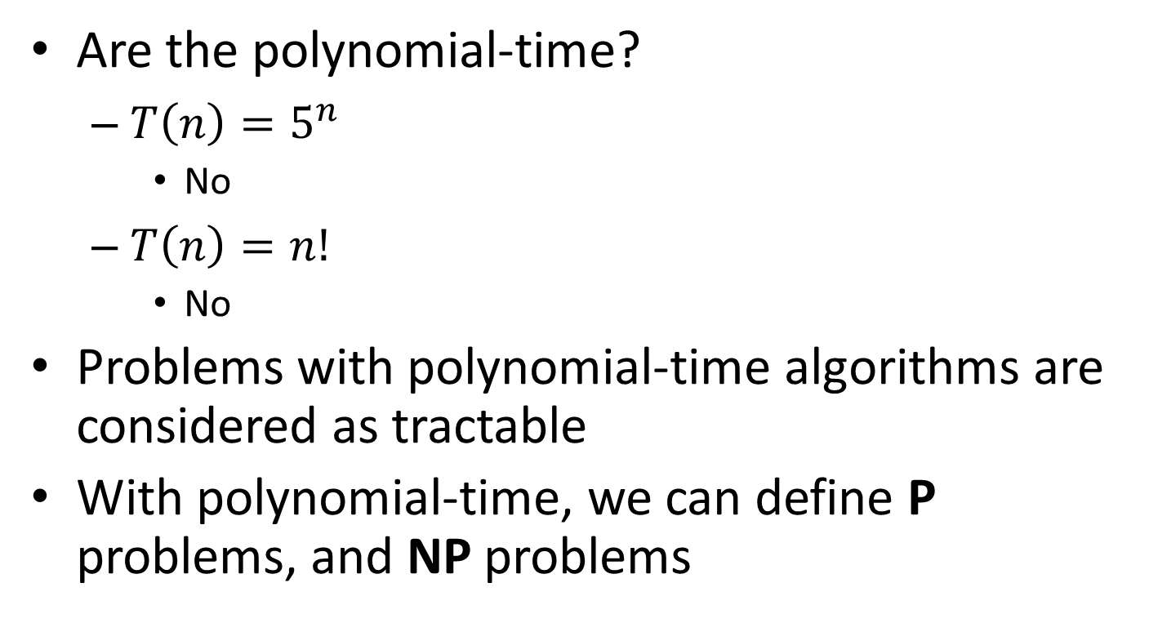
What is polynomial-time?
Are the polynomial-time?
$T\left(n\right)=5^{n}$
No
$T\left(n\right)=n!$
No
Problems with polynomial-time algorithms are considered as tractable
With polynomial-time, we can define P problems, and NP problems

Slide 4
What are P and NP?
P problems
(The original definition) Problems that can be solved by deterministic Turing machine in polynomial-time.
(A equivalent definition) Problems that are solvable in polynomial time.
NP problems
(The original definition) Problems that can be solved by non-deterministic Turing machine in polynomial-time.
(A equivalent definition) Problems that are verifiable in polynomial time.
Given a solution, there is a polynomial-time algorithm to tell if this solution is correct.

Slide 5
What are P and NP?
Polynomial-time verification can be used to easily tell if a problem is a NP problem
E.g.:
Sorting, n-integers
A candidate: an array
Verification: scan it once
Max-heapify, n-nodes:
A candidate: a complete binary search tree
Verification: scan all the nodes once
Find all the sub sets of a given set A, |A|=n
A candidate: a set of set
Verification: check each set

Slide 6
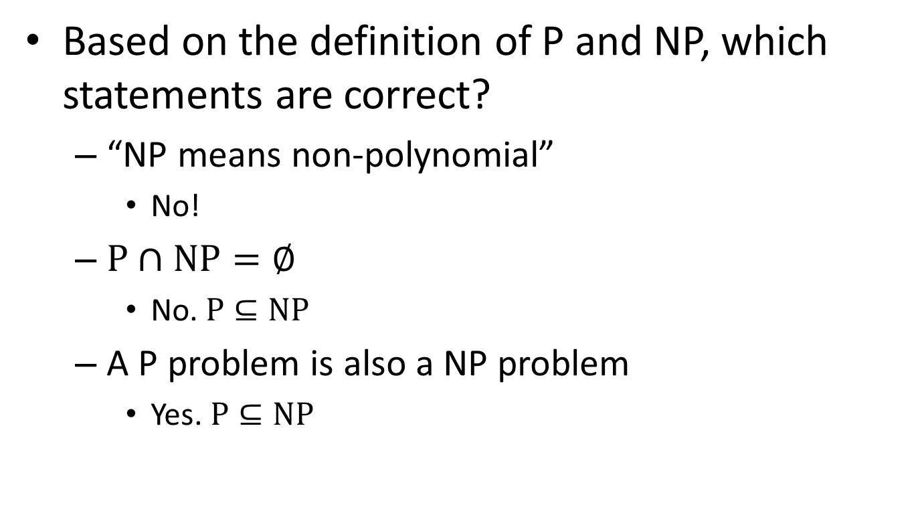
What are P and NP?
Based on the definition of P and NP, which statements are correct?
“NP means non-polynomial”
No!
$P∩NP=∅$
No. $P⊆NP$
A P problem is also a NP problem
Yes. $P⊆NP$

Slide 7
What are P and NP?
any problem solvable by a deterministic Turing machine in polynomial time is also solvable by a nondeterministic Turing machine in polynomial time. Thus, P ⊆ NP
P = NP means whether an NP problem can belong to class P problem. In other words whether every problem whose solution can be verified by a computer in polynomial time can also be solved by a
computer in polynomial time

Slide 8
What are P and NP?
In order to prove that P ≠ NP, we would need to prove that there exists a set of problems X such that:
X falls in NP. There exists an algorithm with which a nondeterministic Turing machine could solve problems in X in polynomial time
X does not fall in P. There exists no algorithm whatsoever with which a deterministic Turing machine could solve problems in X in polynomial time

Slide 9
What are NP-complete problems?
A NP-complete problem(NPC) is
a NP problem
harder than all equal to all NP problems
In other words, NPC problems are the hardest NP problems
So far, no polynomial time algorithms are found for any of NPC problems

Slide 10
What are NP-complete problems?
Most scientists believe:
However, it is not ruled out that:
NP
NP=NPC=P
NPC
P
NP-Hard problems: problems harder than or equal to NPC problems

Slide 11
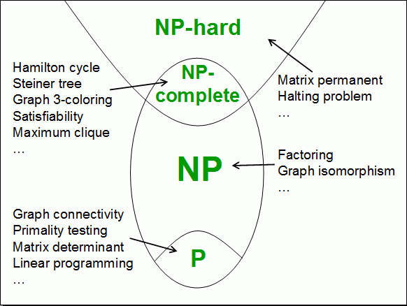

Slide 12
Why we study NPC?
One of the most important reasons is:
If you see a problem is NPC, you can stop from spending time and energy to develop a fast polynomial-time algorithm to solve it.
Just tell your boss it is a NPC problem
How to prove a problem is a NPC problem?

Slide 13
How to prove a problem is a NPC problem?
A common method is to prove that it is not easier than a known NPC problem.
To prove problem A is a NPC problem
Choose a NPC problem B
Develop a polynomial-time algorithm translate A to B
A reduction algorithm
If A can be solved in polynomial time, then B can be solved in polynomial time. It is contradicted with B is a NPC problem.
So, A cannot be solved in polynomial time, it is also a NPC problem.

Slide 14
What if a NPC problem needs to be solved?
Buy a more expensive machine and wait
(could be 1000 years)
Turn to approximation algorithms
Algorithms that produce near optimal solutions

